Slide 1






Team Big-Bytes
Buan, Renz
Marcelina, Shaira
Garcia, Jasper
Atienza, Antoniette
Bautista, Carl

Slide 2
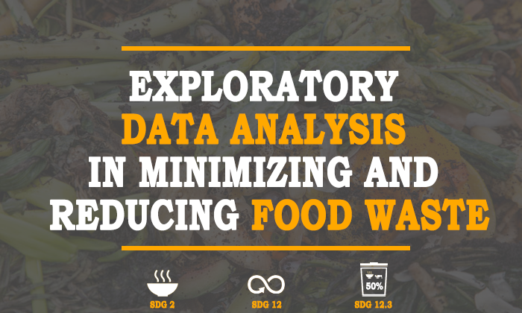

Slide 3

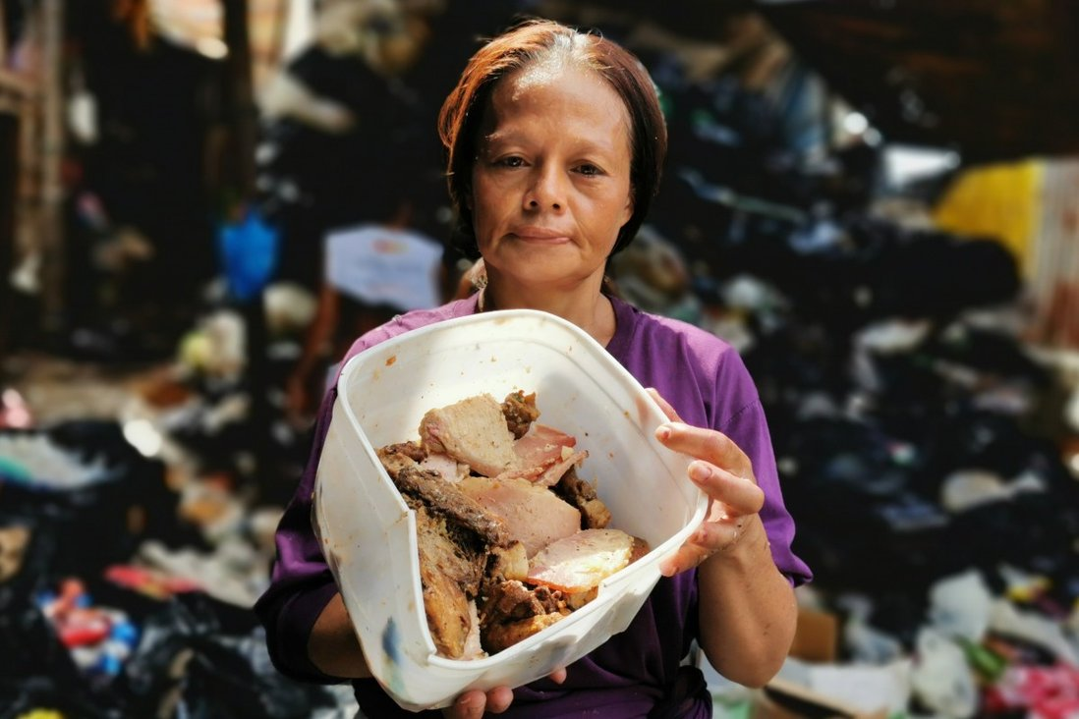
“ALING MYRNA”
Aling Myrna Salazar collects pagpag at Joe’s Junk Shop in Payatas Quezon, Philippines
Photo: SCMP Pictures

Slide 4
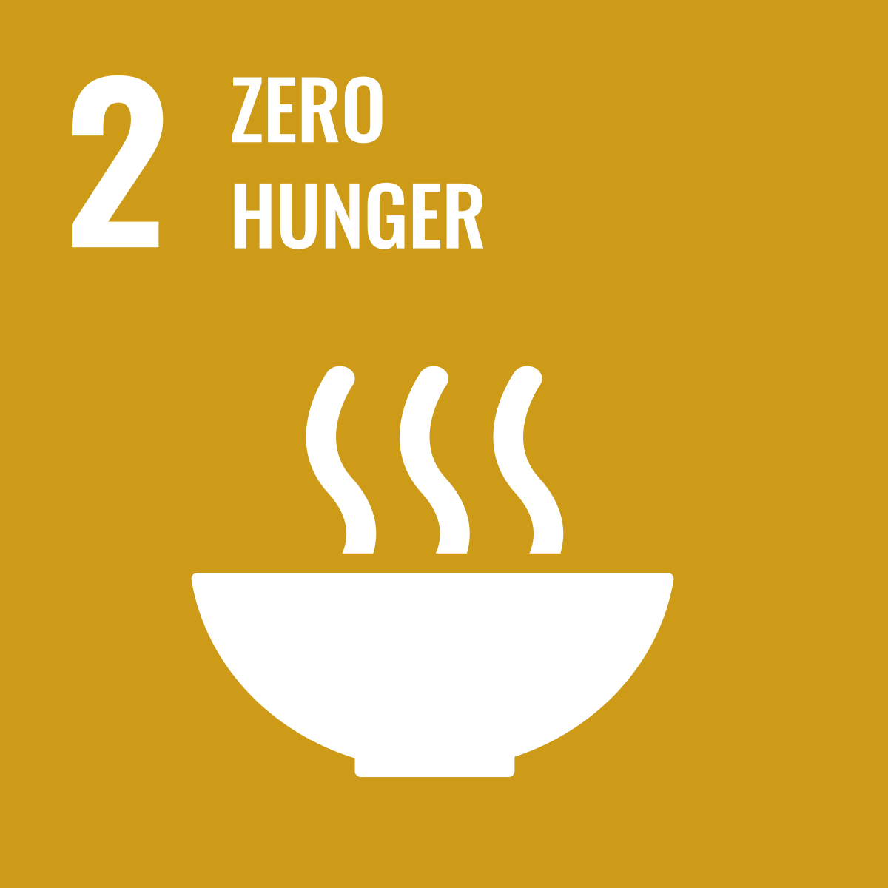
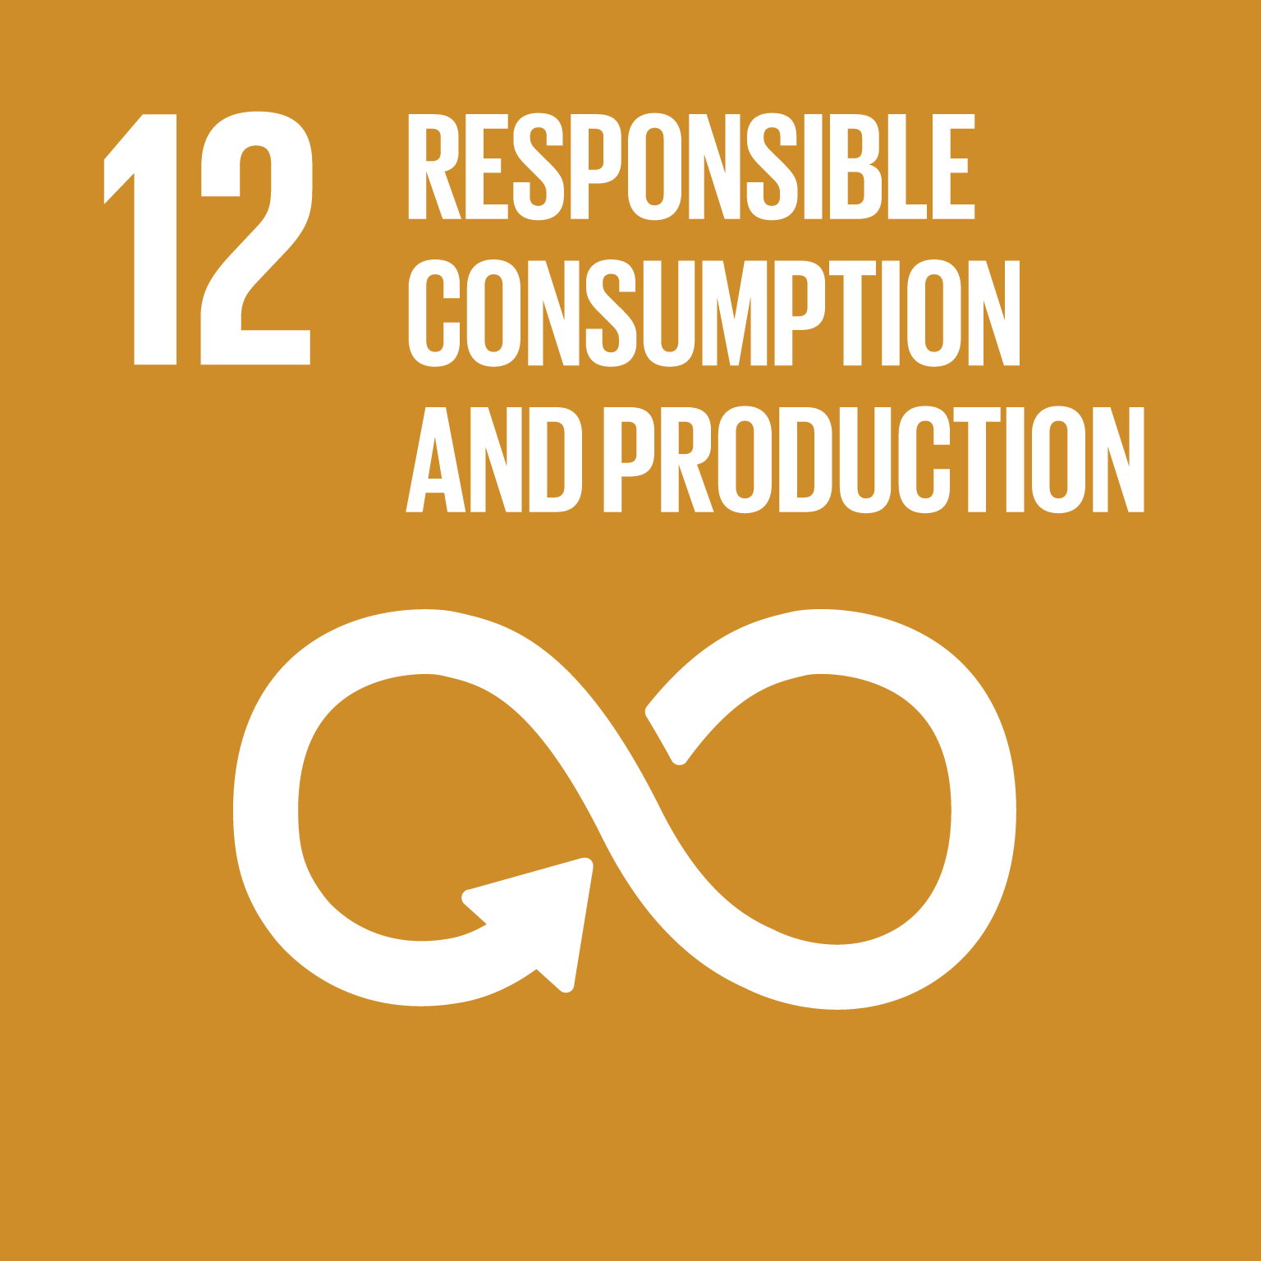
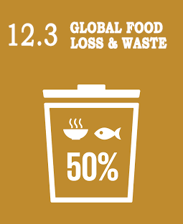
SDG TARGET

Slide 5
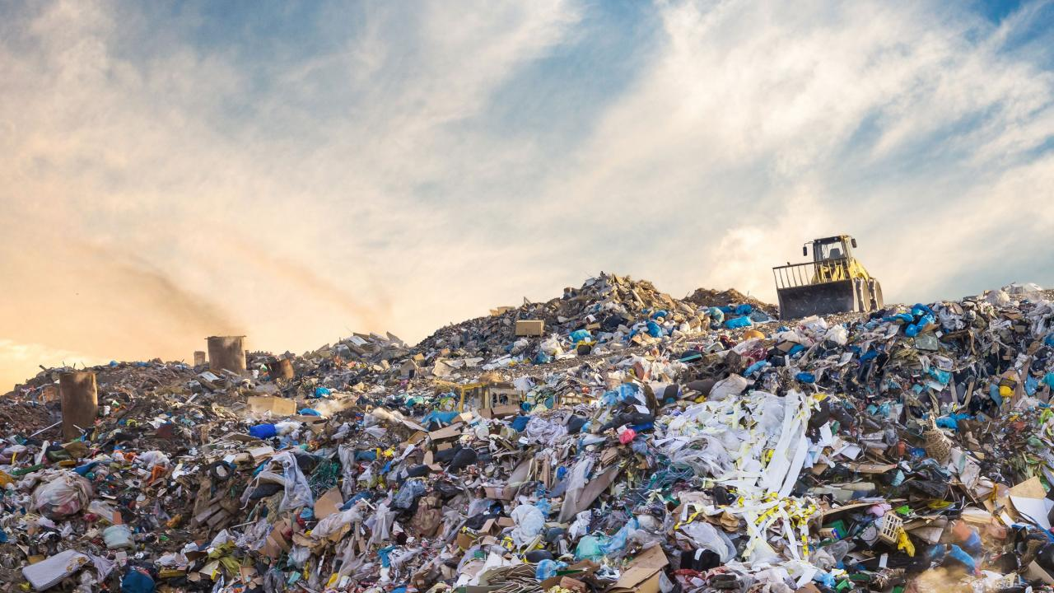
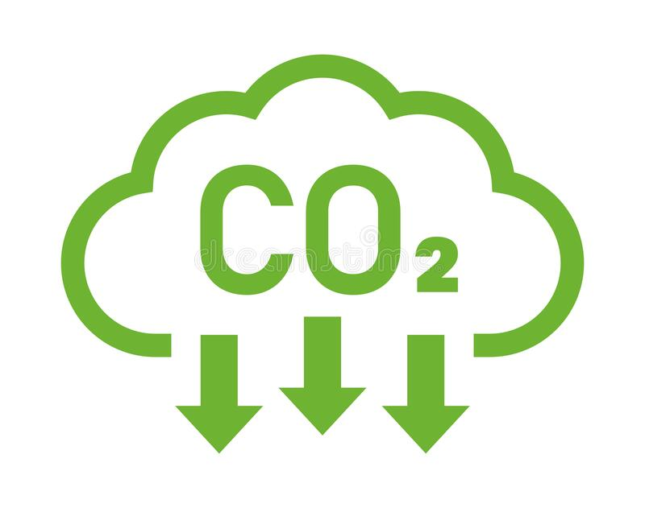
Greenhouse gas emission from food waste
6%
of greenhouse emission
comes from food waste
Source: Our World Data, 2018
One quarter of food emissions comes from the food that is never eaten: 15% of food emissions from food lost in supply chain, and 9% from consumer waste.

Slide 6
Problem Statement
Ineffective interventions in preventing and minimizing food wastes implemented in Southeast Asia
Lack of knowledge of individual in proper storage of food
Buying foods that is more than on what they can consume

Slide 7
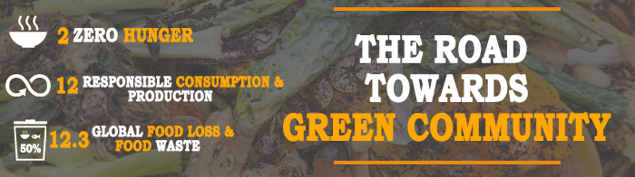

Slide 8
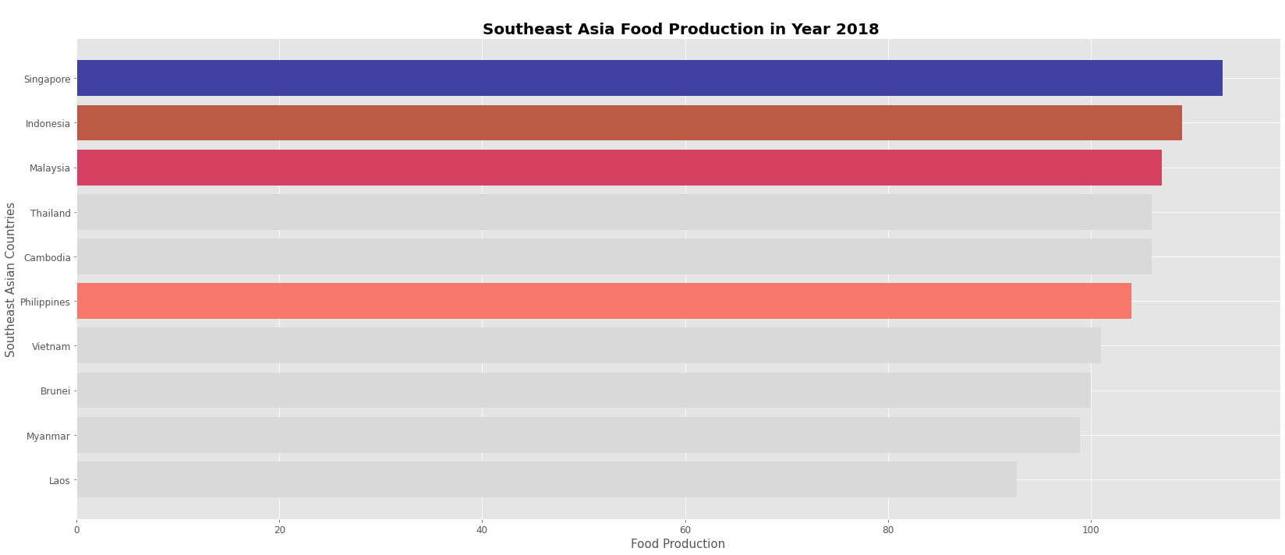
SOUTH-EAST ASIA FOOD PRODUCTION 2018
SOURCE: FREE DATA FROM WORLD BANK VIA GAPMINDER.ORG, CC-BY LICENSE

Slide 9
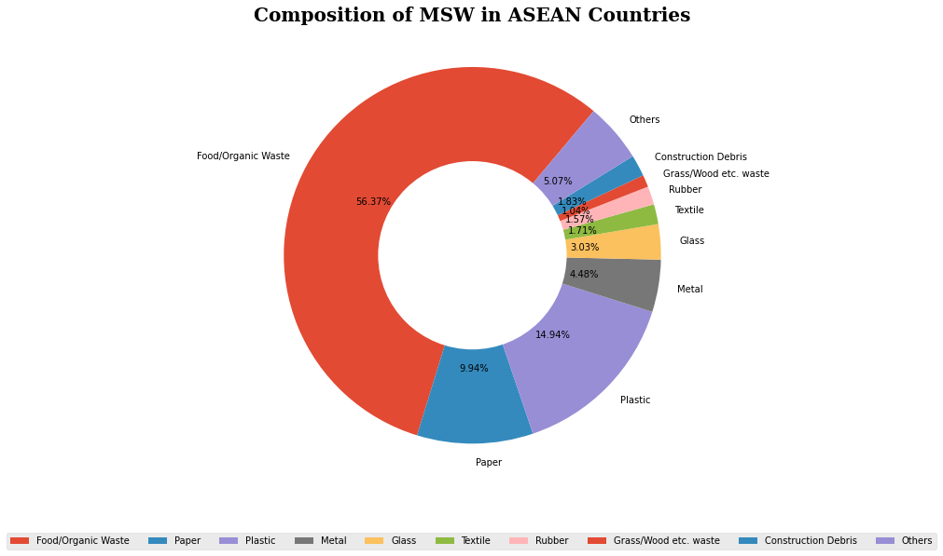
COMPOSITION OF MSW IN ASEAN COUNTRIES
SOURCE: Fourth ASEAN State of Environment Report 2009

Slide 10
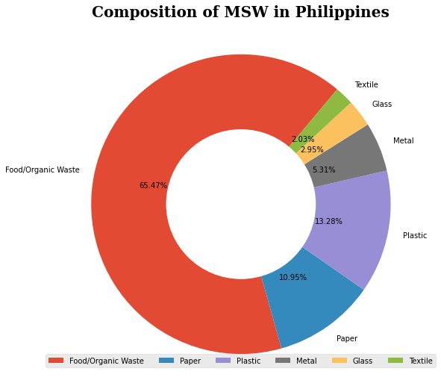
COMPOSITION OF MSW IN PHILIPPINES
SOURCE: Fourth ASEAN State of Environment Report 2009

Slide 11
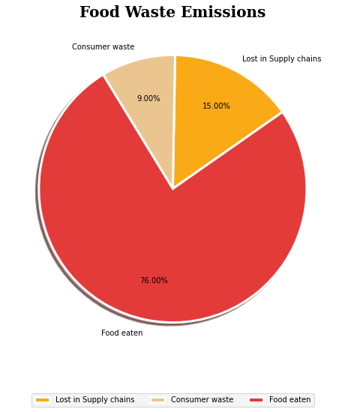
FOOD WASTE EMISSIONS
SOURCE: Our World Data.org

Slide 12
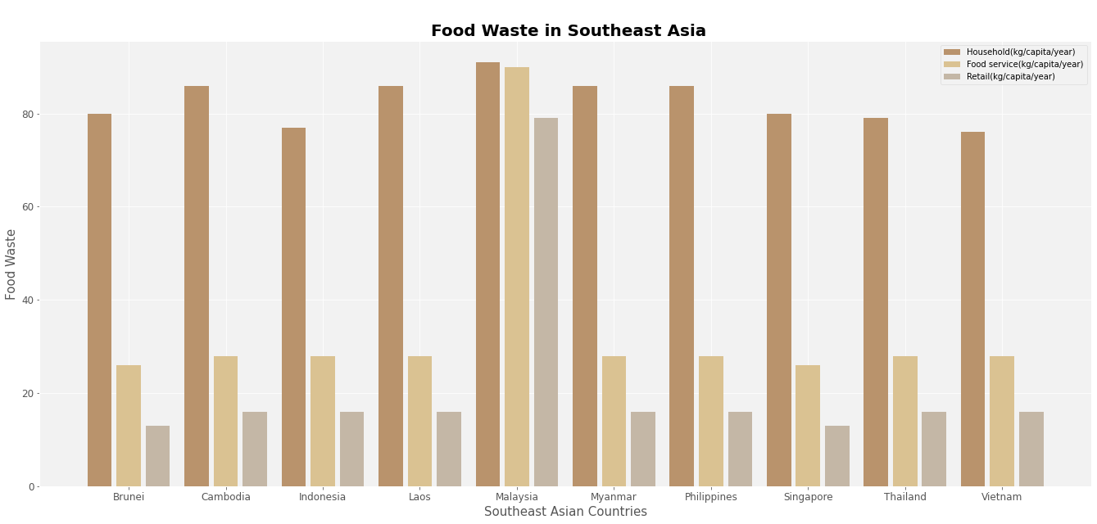
FOOD WASTE IN SOUTH-EAST ASIA
SOURCE: UNEP Food Waste Index Report, 2021

Slide 13
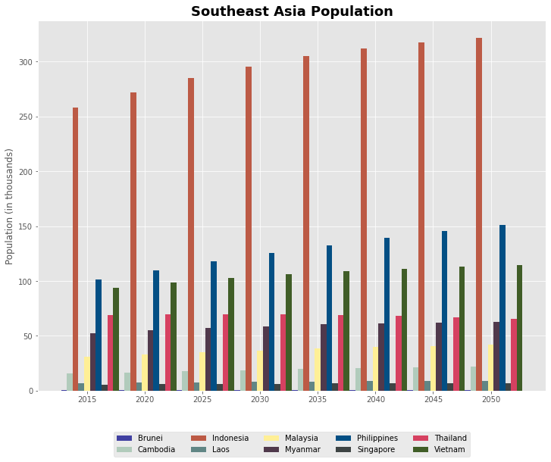
SOUTH-EAST ASIA POPULATION
SOURCE: United Nations, Department of
Economic and Social Affairs,
Population Division (2018).

Slide 14
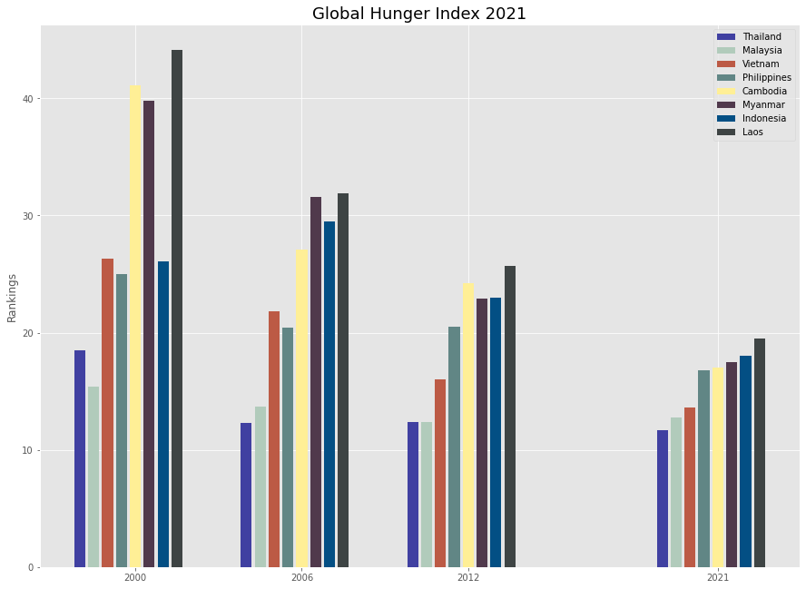
GLOBAL HUNGER INDEX
SOURCE: GLOBAL HUNGER INDEX SCORES BY 2021 GHI RANK

Slide 15
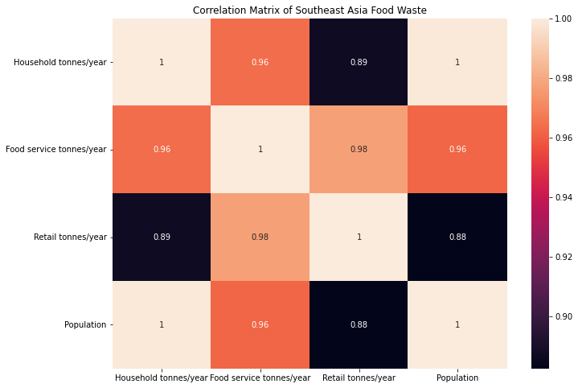
CORRELATION MATRIX

Slide 16
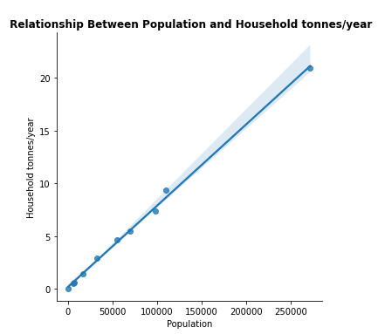
RELATIONSHIP OF POPULATION AND HOUSEHOLD

Slide 17
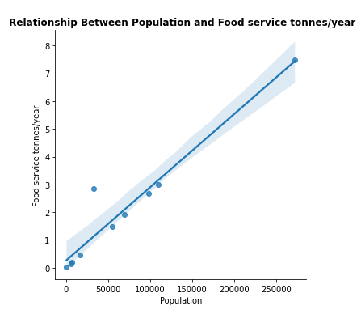
RELATIONSHIP OF POPULATION AND FOOD SERVICE

Slide 18
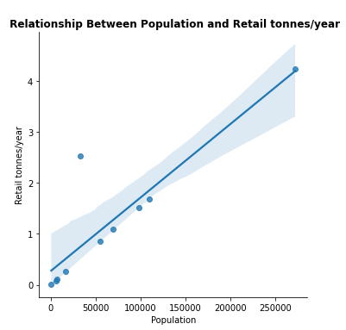
RELATIONSHIP OF POPULATION AND RETAIL

Slide 19



Expected Output
An action plan for a proper consumption of food in order to reduce food waste.

Slide 20



Expected Output
A Food donation campaign for the people in need of foods

Slide 21
THANK YOU!

